Slide 1
JOURNEY PRESENTATION
AKSHAY P

Slide 2
Day 1 – Azure storage overview
•We were given an overview on Azure Storage.
•It offers a variety of storage solutions to help organizations store, manage, and access their data in a scalable, reliable, and secure manner.
•Azure Storage is widely used by businesses and developers for a wide range of applications, including data storage, backup, disaster recovery, and application development.
•We learned how to create a storage account and how to work with containers.
•We also learned about the different data services such as the Blob , Queue, and Table services
•Also learned out LRS and GRS. LRS and GRS are different redundancies of the Azure storage. LRS stands for Locally Redundant Storage, which means that data is stored three times within a single region. GRS stands for Geo-Redundant Storage, which provides additional redundancy for data storage compared to LRS
•Blob Storage is designed for storing unstructured data, such as documents, images, videos, and backups.

Slide 3
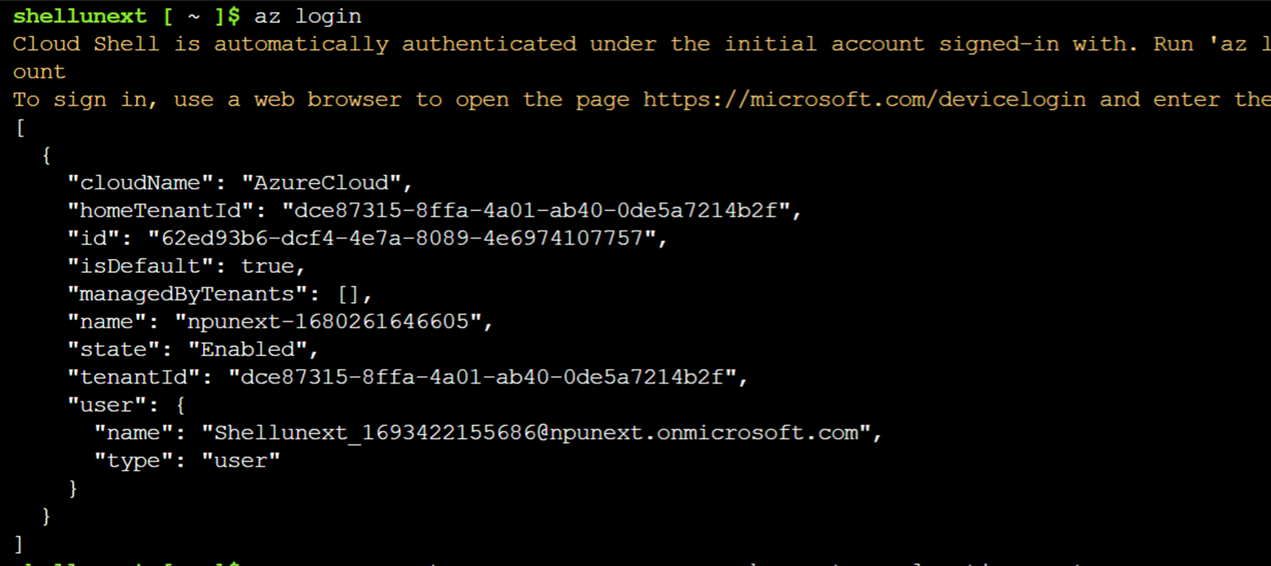
Day 2 – resource group creation using bash

Slide 4
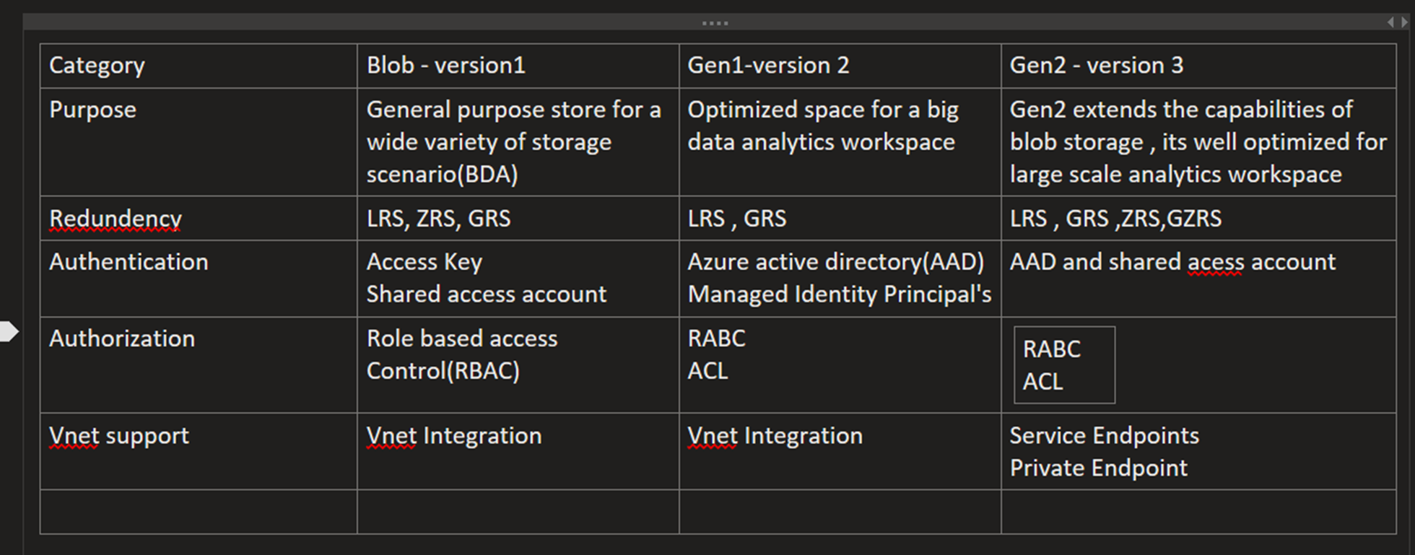
Day 3 – Azure storage overview

Slide 5
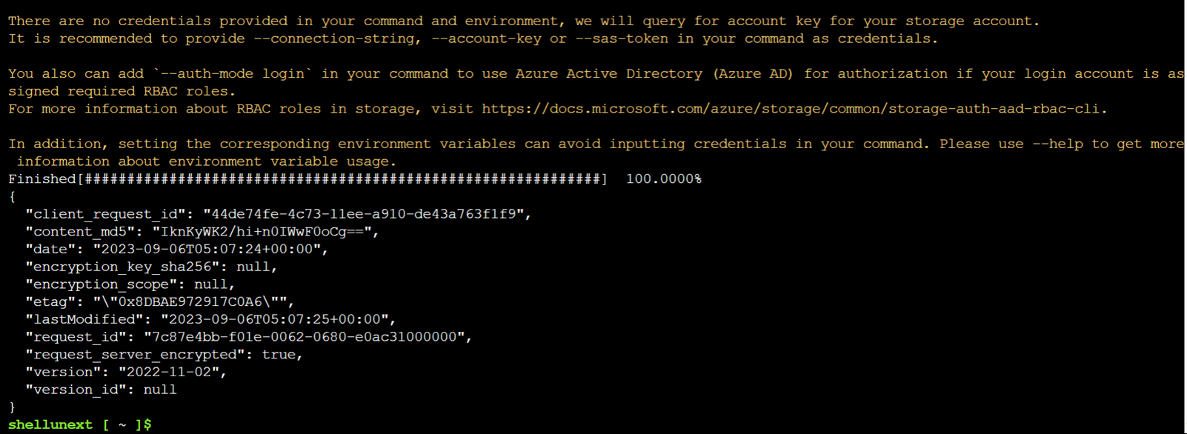

Slide 6
Day 4 – Azure data factory
Azure Data Factory is a cloud-based data integration service that allows us to create data-driven workflows for orchestrating and automating data movement and data transformation. It can be used for various purposes such as:
Supporting data migrations
Getting data from a client’s server or online data to an Azure Data Lake
Azure Data Factory has four key components to define input/output data and process events:
Datasets represent data structures within the data stores. An input dataset represents the input for an activity, and an output dataset represents the output of an activity.
Linked services define the connection information for external resources. Linked services can be reused across multiple datasets and pipelines.
Pipelines define a logical grouping of activities that together perform a task. A pipeline is made up of one or more activities.
Activities are the processing steps performed on the input datasets. Activities can be chained together to form a pipeline.

Slide 7
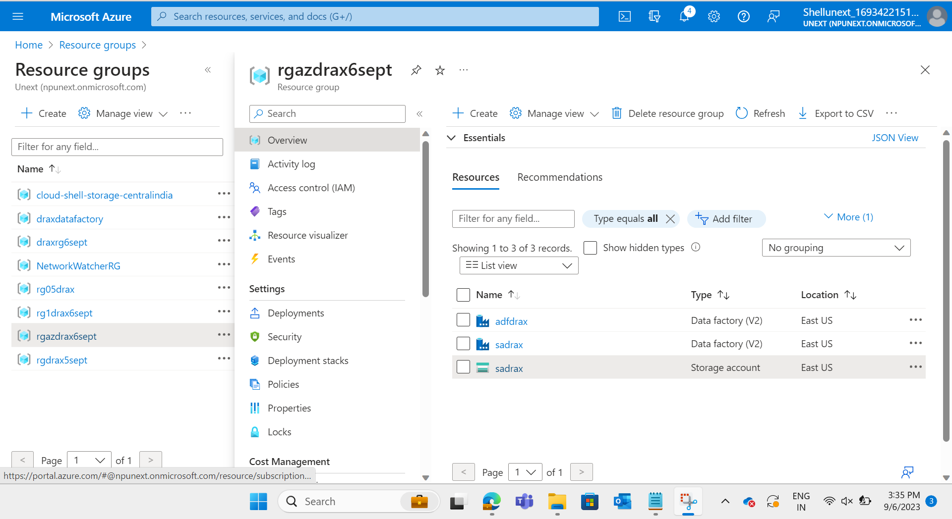
Day 4 & 5 – Azure data factory

Slide 8
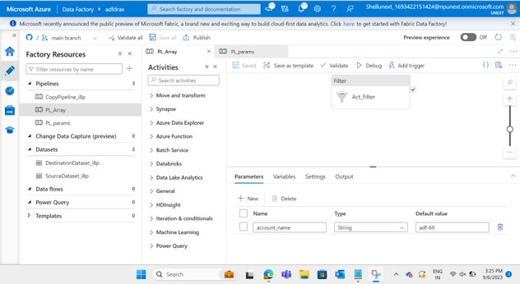

Slide 9
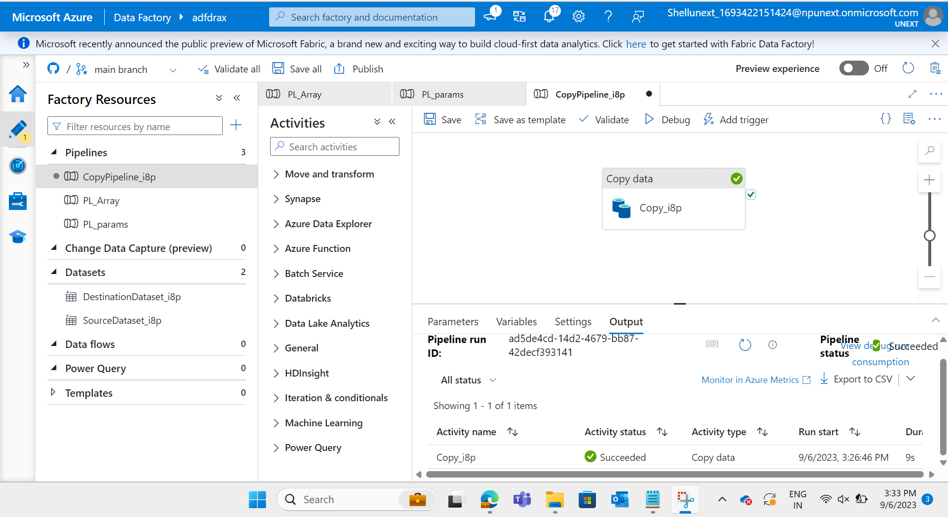

Slide 10
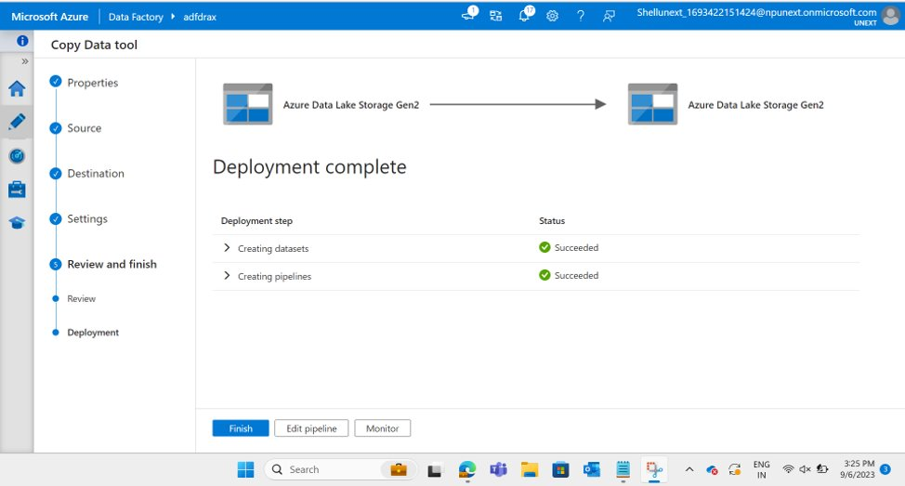

Slide 11
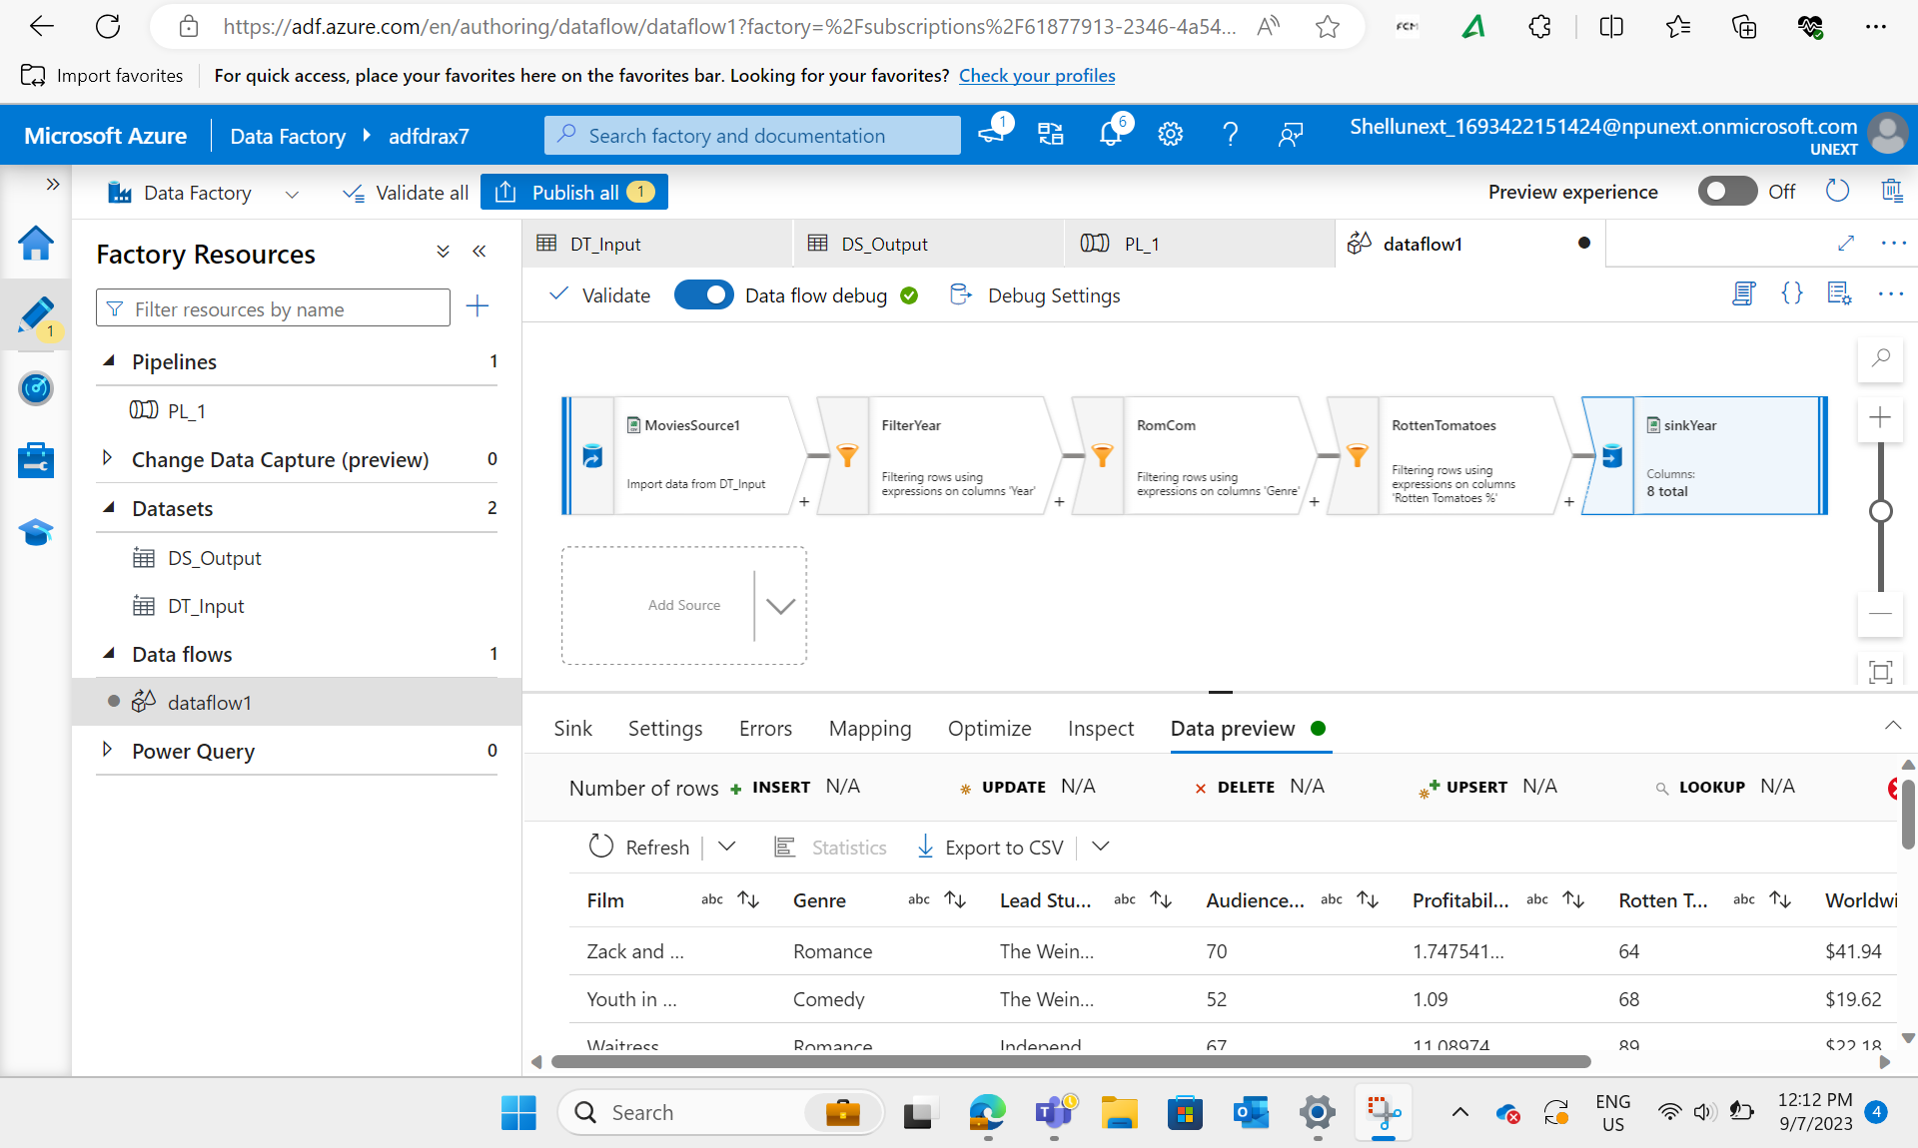

Slide 12
